Slide 1
Lifestyle Referral Pathways and Support
Alcohol
Stop smoking
Healthy Weight
Physical activity
Dementia

Slide 2
Community Alcohol Services
Single Point Of Contact
Addaction Devon alcohol service is the gateway service for any adult with an alcohol problem.
Client or professional can make a referral with the clients consent.

Slide 4
Referrals
How to make a referral –
Call 0845 130 2605
Email alcoholreferraldevon@addaction.org.uk
Post to The referral coordinator
3 the Courtyard
New North Road
Exeter
EX4 4EP

Slide 5
Community Alcohol Services
The client will be offered an appointment within 3 weeks for an assessment.
We will signpost and work with other services to support the clients recovery.
Access to Specialist support, Detox and Rehabilitation.
Access to Recovery support programmes

Slide 6
Breaking Free Online
Breaking Free Online is an award-winning computerised treatment programme for alcohol and drug difficulties. It is now available for GPs within the Devon area to provide to their patients for free.
If you would like to provide this resource to your patients, please contact Jane Wright at jwright@breakingfreeonline.com
or by telephone on 0161 834 4647.

Slide 8
Specialist Stop Smoking Service
Specialist advisors offering clinics in community venues across Devon
Many clinics available after 5pm
The service also provides training to Primary Care Staff wanting to offer their own in house stop smoking service
Clients can self refer or you can refer them
Contact 01884 836024 for more details

Slide 9
Healthy Weight (available February 2014)
Tier 1 - support (non-funded)
BMI >25 – 29.9 (kg/m2) or South Asian population and > 22.5- 27.4 (kg/m2) with co-morbidities *
BMI >30 – 34.9 (kg/m2) or South Asian population and >27.5- 32.4 (kg/m2) without co-morbidities
Considered ready to change by Health Professional
Tier 2 - funded weight management on referral voucher
BMI >30 (kg/m2) or South Asian population and >27.5 (kg/m2) with co-morbidities*
BMI >35 (kg/m2) or South Asian population and >32.5 (kg/m2) without co-morbidities
Considered ready to change by Health Professional
* type 2 diabetes or previous gestational diabetes, uncontrolled hypertension, hyperlipidaemia uncorrected by maximum doses of statins, sleep apnoea, severe osteoarthritis

Slide 10
Healthy Weight Services
All clients must be referred by a GP/health professional
Health Promotion Devon will determine which Tier the client can access and which service they are eligible for
Referral via electronic referral form, fax or post to Health Promotion Devon
Details of referral process to follow and further detail in February newsletter

Slide 11
Physical Activity
Exercise Referral Schemes
12 – 16 week exercise programme referred to by health professional, supported by a qualified instructor and paid for by the patient
Available through some local leisure centres in Devon
Check http://www.devonhealthandwellbeing.org.uk/wp-content/uploads/2012/10/Exercise-Referral-Schemes_Devon.pdf for details of your local scheme.

Slide 12
Get Active Devon
Physical Activity Finder Tool
Available at: www.getactivedevon.co.uk
Helps the heath professional to signpost their patient to local physical activity opportunities

Slide 13
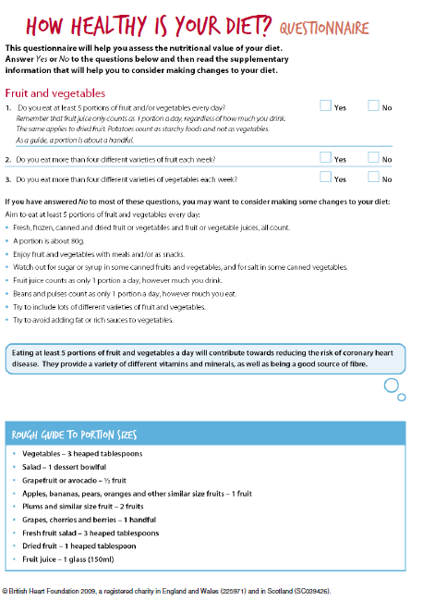
Where to get patient information materials
http://www.devonhealthandwellbeing.org.uk/library/prof/weight/

Slide 14
Dementia
Every person aged from 65 to 74 years who is undergoing a health check shall be given information at the time of the health check designed to raise their awareness of dementia and of the availability of memory services which offer further advice and assistance to people who may be experiencing memory difficulties, including making a diagnosis of dementia.

Slide 15
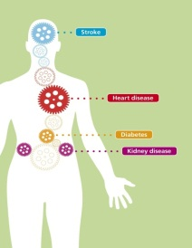
Health Check Resources www.devonhealthandwellbeing.org.uk/library/prof/health-checks/

Slide 16
Referral summary
 | Can client self refer? | Contact number for referring | Other useful information
Alcohol | Yes | 0845 130 2605
Stop Smoking | Yes | 01884 836024 | www.healthpromotiondevon.nhs.uk or email ndht.hpd@nhs.net or post referrals (see final slide)
Healthy Weight | No | 01884 836024 | www.healthpromotiondevon.nhs.uk or email ndht.hpd@nhs.net address or post referrals (see final slide)
Physical Activity | Yes | N/A | http://getactivedevon.co.uk
Dementia | Give information
www.devonhealthandwellbeing.org.uk/library/prof/health-checks/

Slide 17
Further information
Health Promotion Devon
Culm Valley Integrated centre for Health
Willand Road
Cullompton
EX15 1FE
Tel: 01884 836024
tina.henry@devon.gov.uk
On any other issues related to Healthchecks

