Slide 1
GET ACTIVE DEVON
‘Physical Activity Finder Tool’
Lara Snowdon & Lucy O’Loughlin
Public Health Devon

Slide 2
Fit for the Future?
Introductions
WIFI: Bristol City Hotel (no password)
www.getactivedevon.co.uk

Slide 3
Fit for the Future?
Showcase: Get Active Devon
www.getactivedevon.co.uk
Workshop
ICT and physical activity – starting the discussion
Double-edged sword/ agent of change?
PHE Physical Activity Implementation Framework

Slide 4
GET ACTIVE DEVON!
Local Practice Showcase

Slide 5
Get Active Devon – Development
Primary care professionals
Online PA resource
Sensitive to range of patient preferences
Scoping – researched a range of options:
Database
Feed from existing database(s)
Costly and resource intensive
Deteriorate

Slide 6
Get Active Devon – Innovation
Google
Patient preferences
Intensity, cost, health, group size etc.
Generates a tailor-made list of activities
Suitable for patient
www.getactivedevon.co.uk

Slide 7
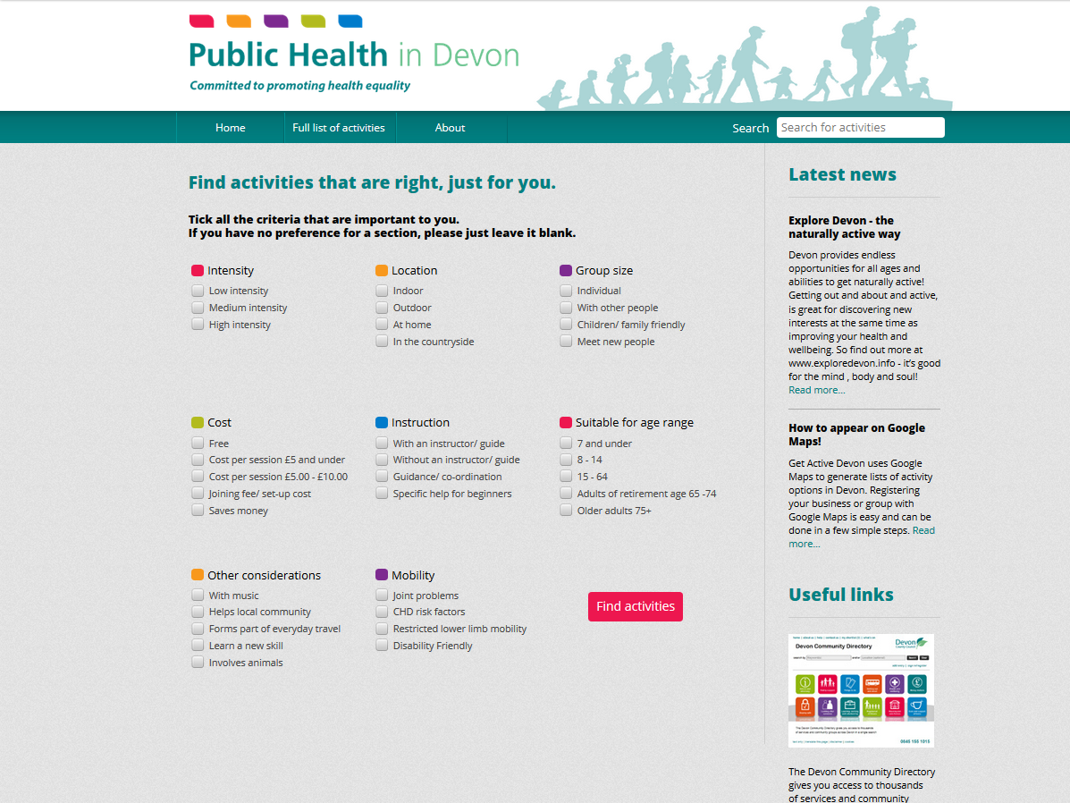

Slide 8
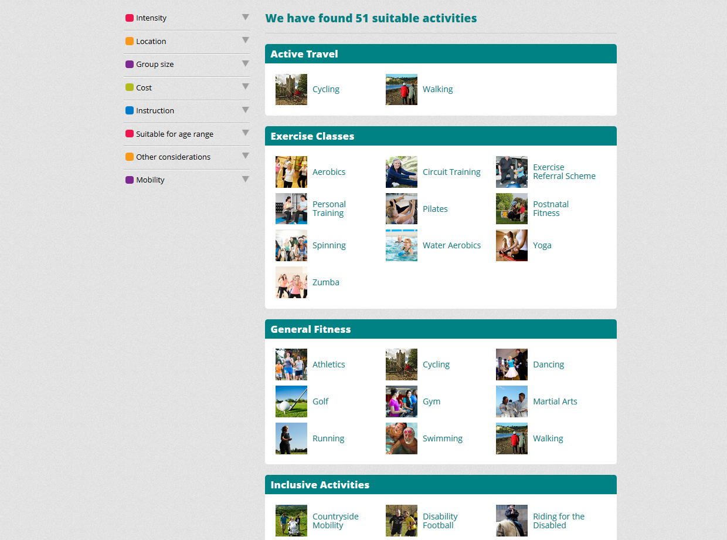

Slide 9
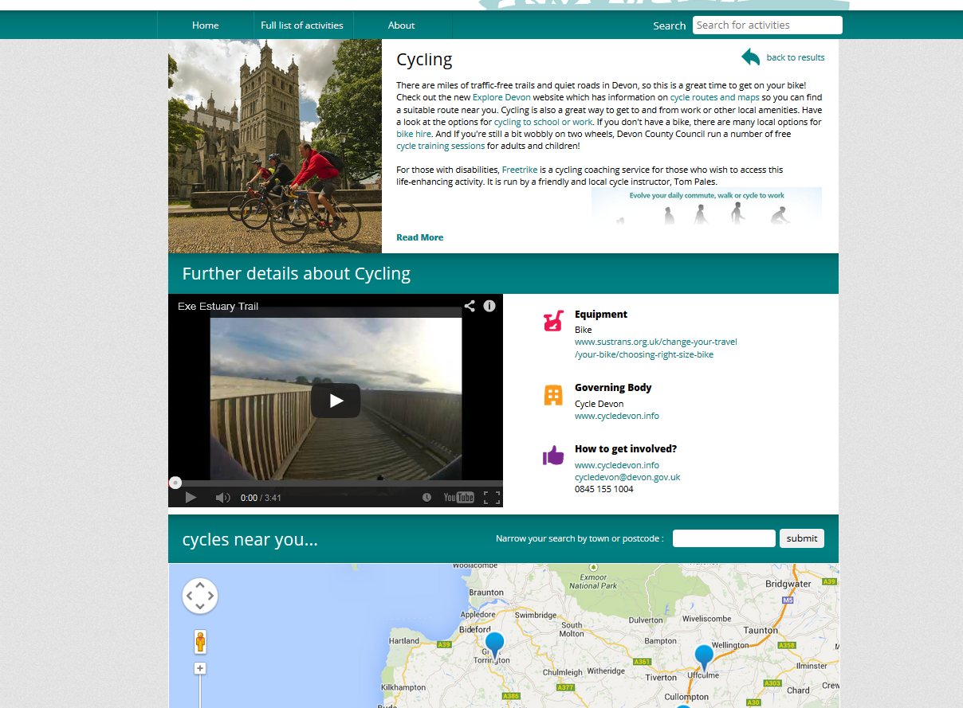

Slide 10
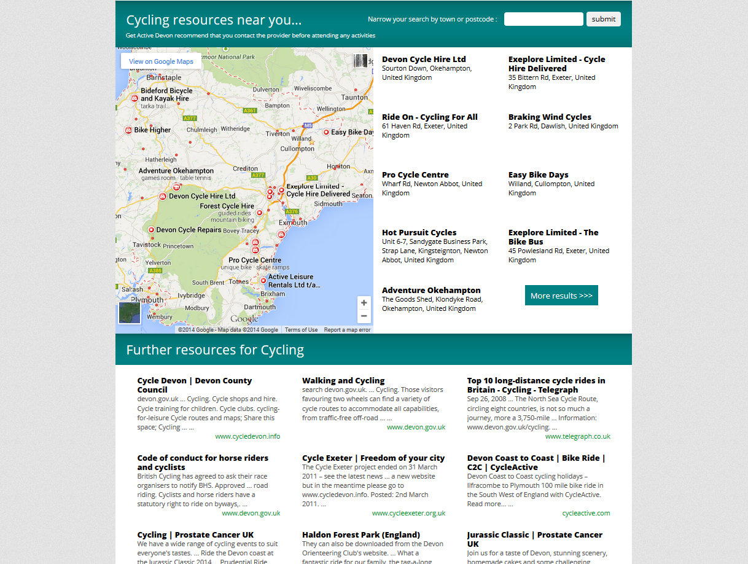

Slide 11
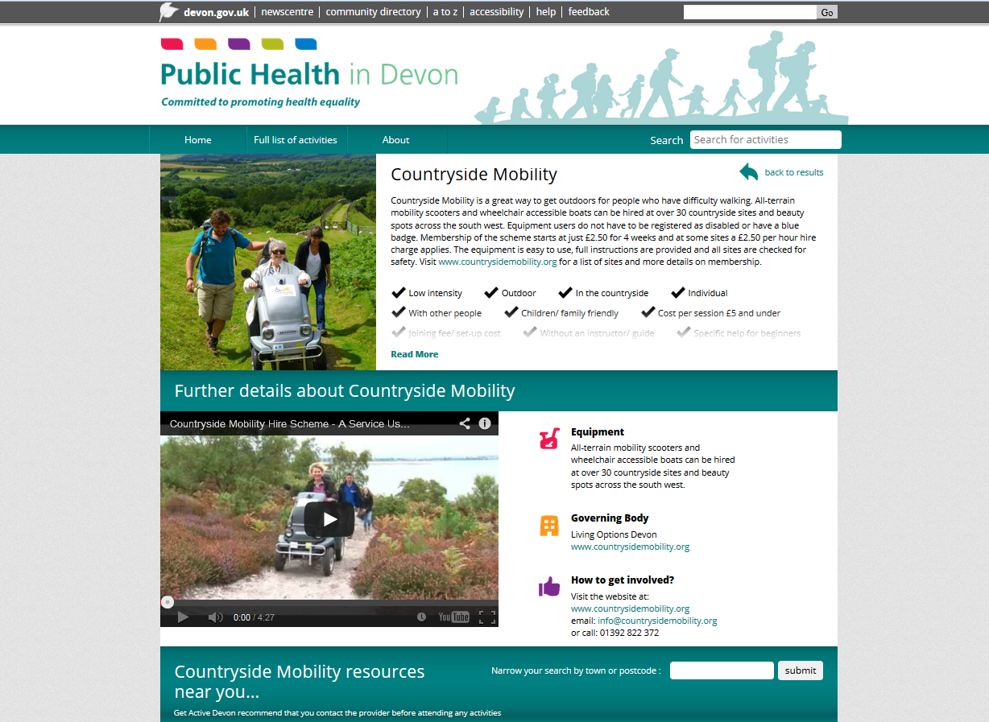

Slide 12
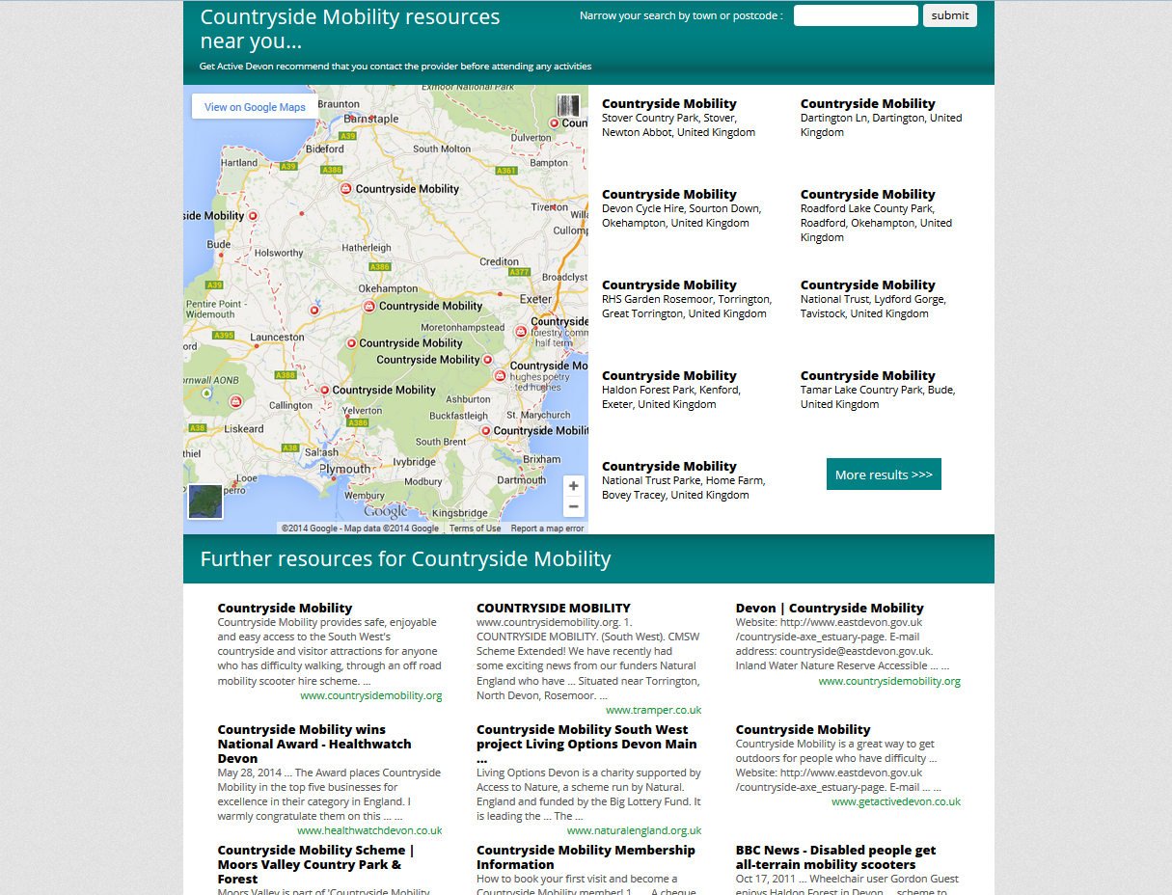

Slide 13
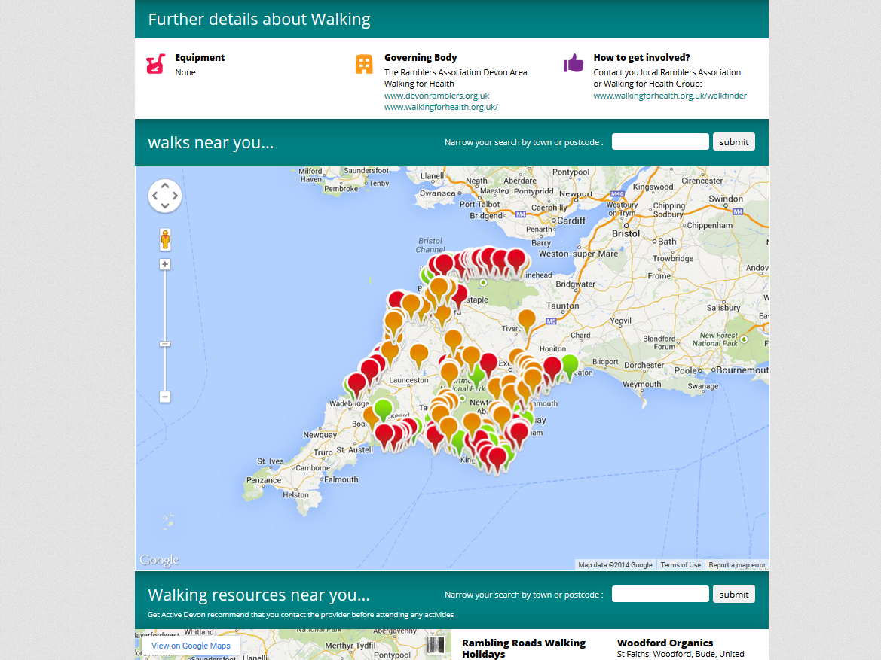

Slide 14
Get Active Devon – Benefits
Not limited to primary care
Suited to patient
Low cost and resource
Improve over time
PA providers improve web presence
Open data
Model - huge potential

Slide 15
Get Active Devon – Challenges
As good as Google …
Variable
No control over what is displayed
Informed user – effective

Slide 16
Get Active Devon – Next Steps
Working with PA providers to improve web presence
Working with partners to share data
Roll out
Public facing?
Beyond PA?

Slide 17
GET ACTIVE DEVON! Questions?

Slide 18
WORKSHOP Fit for the Future?
ICT & Physical Activity

Slide 19
Fit for the Future?
What apps, gadgets, technology, websites etc. do you use to support your involvement with physical activity?
Why do you use these? What is it that makes these devices/ apps/ websites etc. useful?

Slide 20
Fit for the Future?
Thinking strategically about ICT and PA
Pooling your experience
Double-edged sword? Agent of change
What can PHE do?
Complexity
Focus

Slide 21
Fit for the Future?
Where we are now
The journey
Where we want to be
PHE Physical Activity Implementation Framework

Slide 22
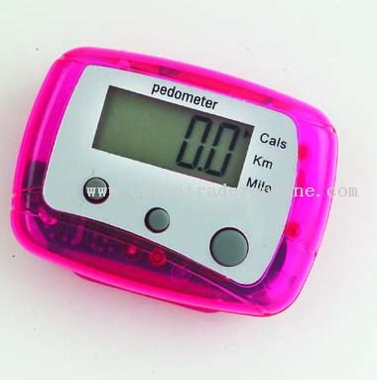
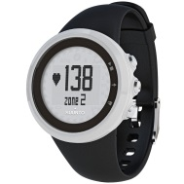
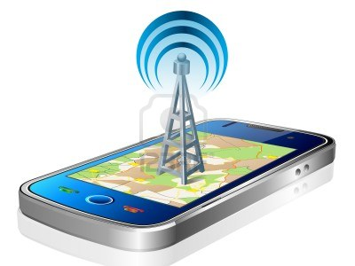
Where are we now?
GPS
GIS
Sharing

Slide 23
Fit for the Future?

Slide 24
McDonalds:

Slide 25
Walking for Health:

Slide 26
Cycling:

Slide 27
Zumba:

Slide 28
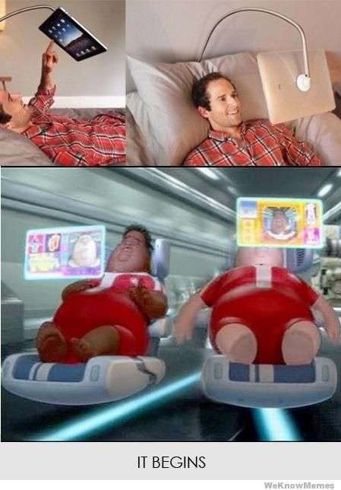
Fit for the Future?

Slide 29
Fit for the Future?
What do we want the relationship between ICT and PA to look like in 2034?
What actions can PHE take to improve the relationship between ICT and physical activity?

Slide 30
Summary
Good examples
Vision
Actions for PHE

